Slide 1

KAA THE SNAKE
Gomez, Ken Gabriel D.
CITCS 1-E CC3

Slide 2
I. PROJECT DESCRIPTION

Slide 3
Story and Concept Based on:
*The Jungle Book by Rudyard Kipling is an adventure story about a man-cub named Mowgli. Mowgli is hunted by an evil tiger named Shere Khan. Mowgli tries to live a peaceful life with other humans, but is too wild for them and too human for the wolves. Eventually Mowgli finds a home in the jungle with a pack of his own.

Slide 4
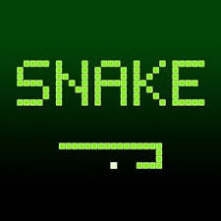
Algorithm and Gameplay based on:
*Snake is the common name for a video game concept where the player maneuvers a line which grows in length, with the line itself being a primary obstacle. The concept originated in the 1976 arcade game Blockade, and the ease of implementing Snake has led to hundreds of versions (some of which have the word snake or worm in the title) for many platforms. After a variant was preloaded on Nokia mobile phones in 1998, there was a resurgence of interest in the snake concept as it found a larger audience. There are over 300 Snake-like games for iOS alone.

Slide 5
II.GAME DESCRIPTION

Slide 6
Kaa (The Snake) is looking for Mowgli. While he is looking for Mowgli, he notice that there are apples on the floor, and those apples are from Mowgli. In order to find Mowgli, he must follow the apples that Mowgli dropped.

Slide 7
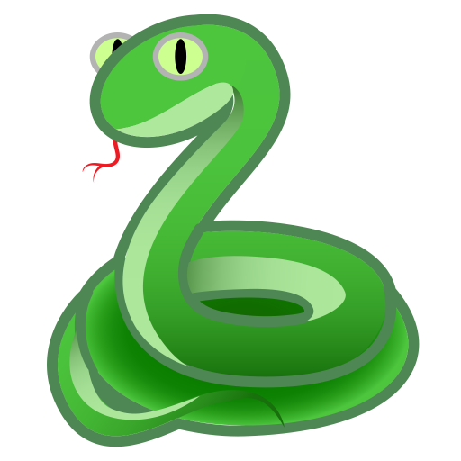
*This is Kaa, control Kaa to find Mowgli.
*Apples that Mowgli dropped.

Slide 8
III. GAMEPLAY

Slide 9
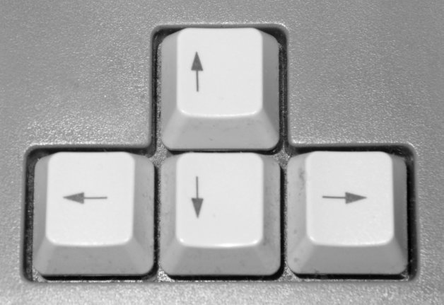
*UP, DOWN, LEFT, RIGHT KEYS:
-Makes the character move across the panel/map. Will also go up and down the menu with the options of:

Slide 10
How to finish the game:
*Kaa (The Snake), must eat an apple continuously and while he’s eating the apple, Kaa will get longer and longer. The more apple you eat, the more points you will get. If Kaa run through a wall or he bit himself the game will end.

Slide 11
SIGNIFICANT CODES

Slide 12
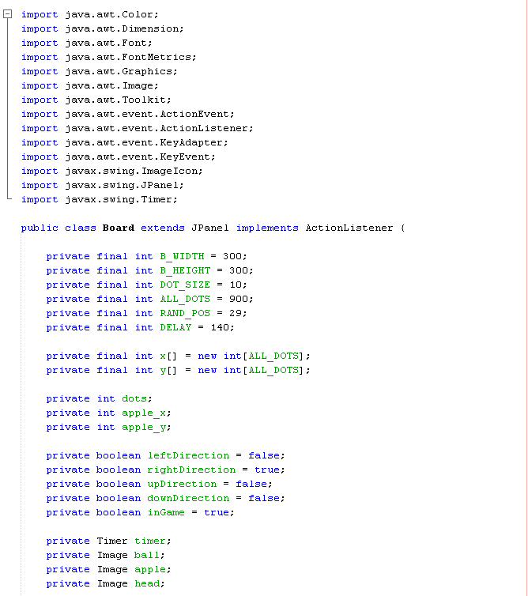
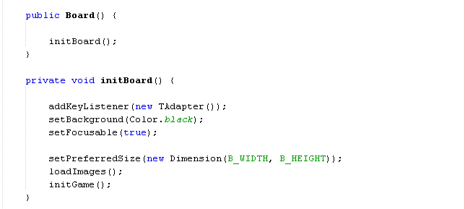
GAME PANEL

Slide 13
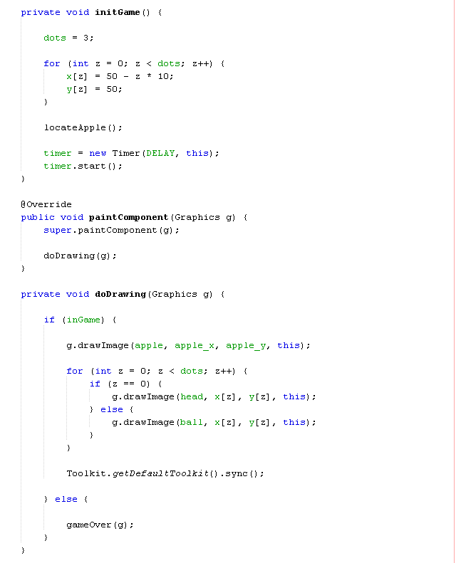
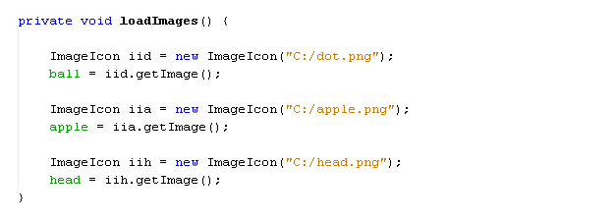
CONTENT

Slide 14
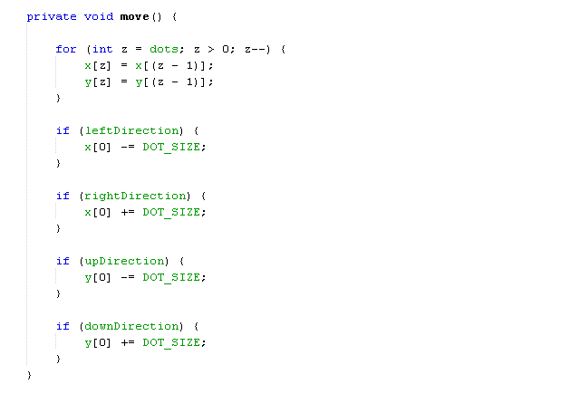
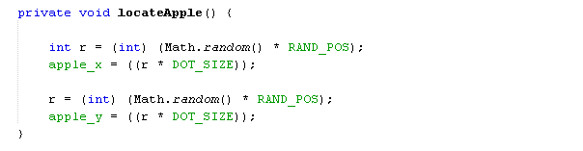
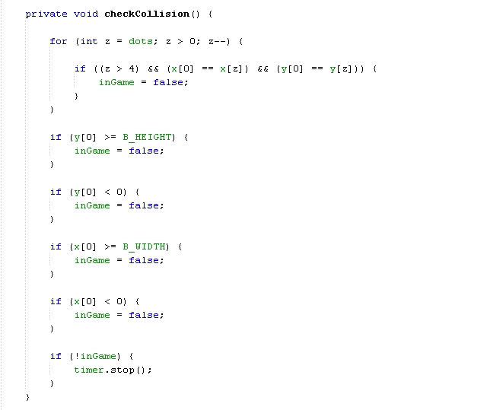
PLAY STATE

Slide 15
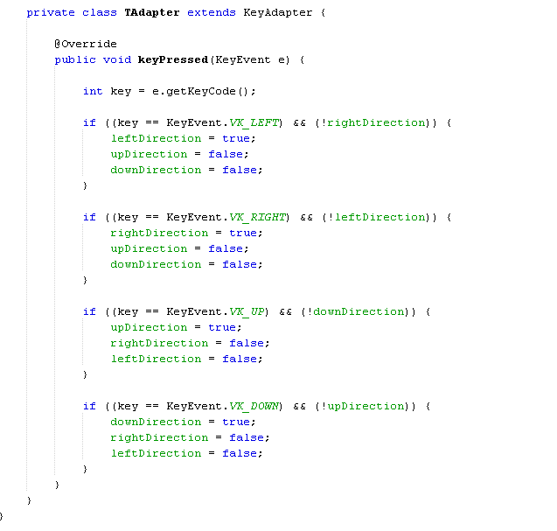
ENTITY

Slide 16
ANIMATION

